Slide 1


Smart Inventory Management and Demand Prediction System
Capstone Project
Supervisor:
Dr. Mony Krishna
SIMATS Engineering
Presented by:
Shaik Ashraf(192324088)
Batta Siva Shirish super hero(192324016)
Bhanu Teja(192325016)
KB Sai Krishna(192325037)

Slide 2
Introduction
Retail and warehouse businesses handle thousands of products, and manual inventory tracking often leads to stockouts, overstocking, and lost revenue.
Demand for products fluctuates due to seasonality, trends, and promotions, making accurate forecasting difficult using traditional methods.
The Smart Inventory Management and Demand Prediction System is designed to automate stock tracking and forecast future demand using data analytics and machine learning.
The platform continuously monitors stock levels and predicts upcoming demand, helping businesses plan purchases and avoid shortages.
It provides automated alerts, reorder recommendations, and analytical dashboards to support faster, data-driven decisions.

Slide 3
Objectives
To develop a centralized platform for real-time tracking of stock levels across warehouses and stores.
To build a machine learning model that accurately predicts future product demand using historical sales data.
To implement automated low-stock alerts and intelligent reorder recommendations.
To provide a reporting dashboard for demand trends, sales analytics, and inventory turnover.
To enable store managers and suppliers to access accurate, real-time inventory information for better coordination.

Slide 4
Problem Statement
Existing System
Existing inventory tracking is largely manual, using spreadsheets or basic software that requires constant human updates.
Limited or no predictive intelligence is available to anticipate future product demand.
Inventory data and sales history are often scattered across disconnected systems, making analysis difficult.
Drawbacks of Existing System
Manual tracking increases the chances of human error and delayed updates.
Businesses frequently face stockouts, lost sales, or excess inventory due to inaccurate demand estimation.
Lack of real-time visibility leads to delayed decision-making and higher operational costs.

Slide 5
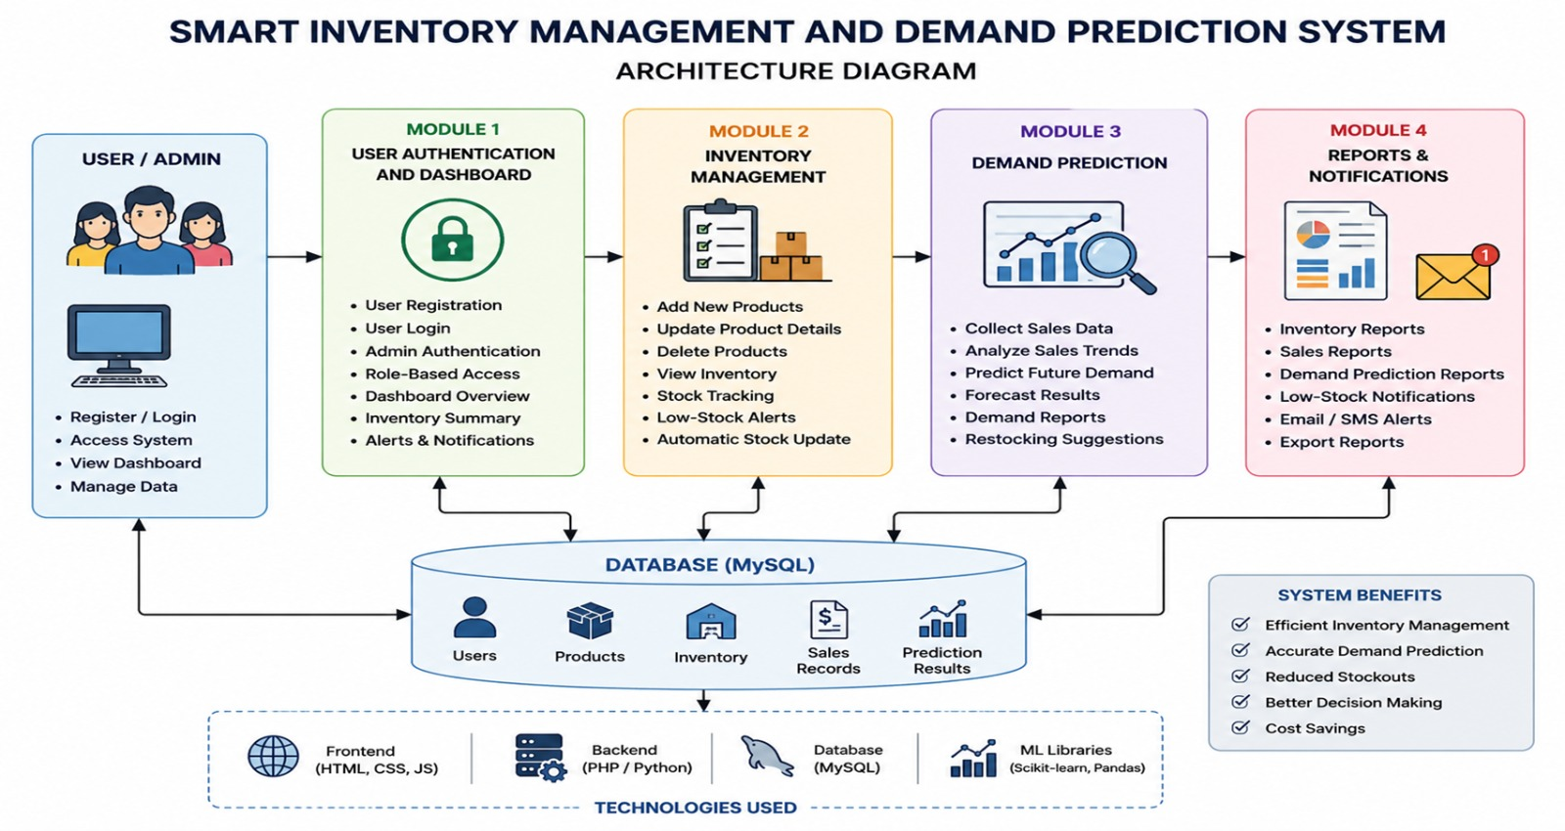
System Architecture / Workflow

Slide 6
List of Modules
Module 1: Inventory Management
Module 2: Demand Prediction Engine
Module 3: Alerts & Reorder Management
Module 4: Analytics & Reporting Dashboard

Slide 7
References
Silver, E.A., Pyke, D.F. & Peterson, R. – Inventory Management and Production Planning and Scheduling (1998)
Hyndman, R.J. & Athanasopoulos, G. – Forecasting: Principles and Practice (2018)
Chopra, S. & Meindl, P. – Supply Chain Management: Strategy, Planning, and Operation (2016)
Makridakis, S., Spiliotis, E. & Assimakopoulos, V. – The M4 Competition: 100,000 time series and 61 forecasting methods (2020)
Waller, M.A. & Fawcett, S.E. – Data Science, Predictive Analytics, and Big Data: A Revolution That Will Transform Supply Chain Design and Management (2013)

Slide 8
Thank You

